Slide 1
New Jersey Checklist

Slide 2
Why have a NJ Checklist
To capture information from the taxpayer in the interview that is unique to preparing the NJ return
To have a place to annotate information that is modified or not carried forward from the federal return
To help the preparer enter the above information in the correct location in TaxSlayer
Should be completed for each NJ tax return

Slide 3
How to Find the NJ Checklist
Go to TaxPrep4Free.org
Select the Preparer Page
Select the NJ checklist from the top of the right column See the next slide.
Print a copy of the checklist

Slide 4
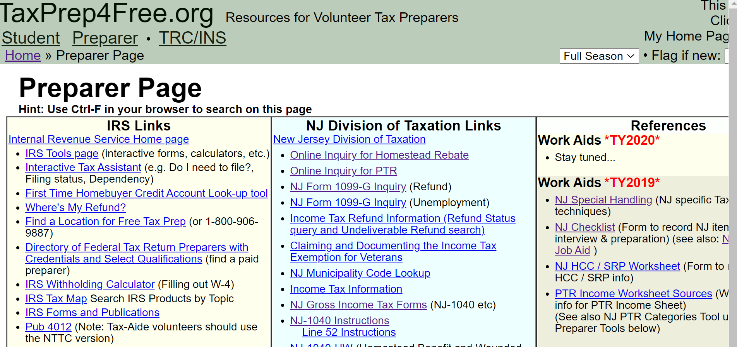
TaxPrep4Free.org Location

Slide 5
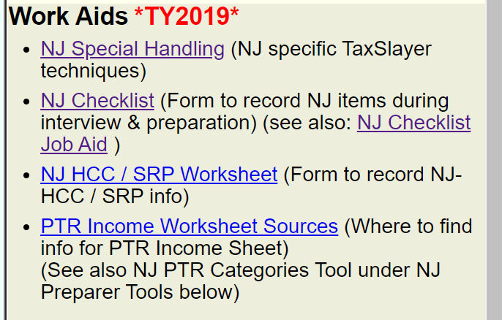
How to get Help
For help click on the “ NJ Checklist Job Aide”

Slide 6
Relationship to NJ TaxSlayer Software
The menu of the NJ return in TaxSlayer matches the headings of each section of the NJ Checklist sections

Slide 7
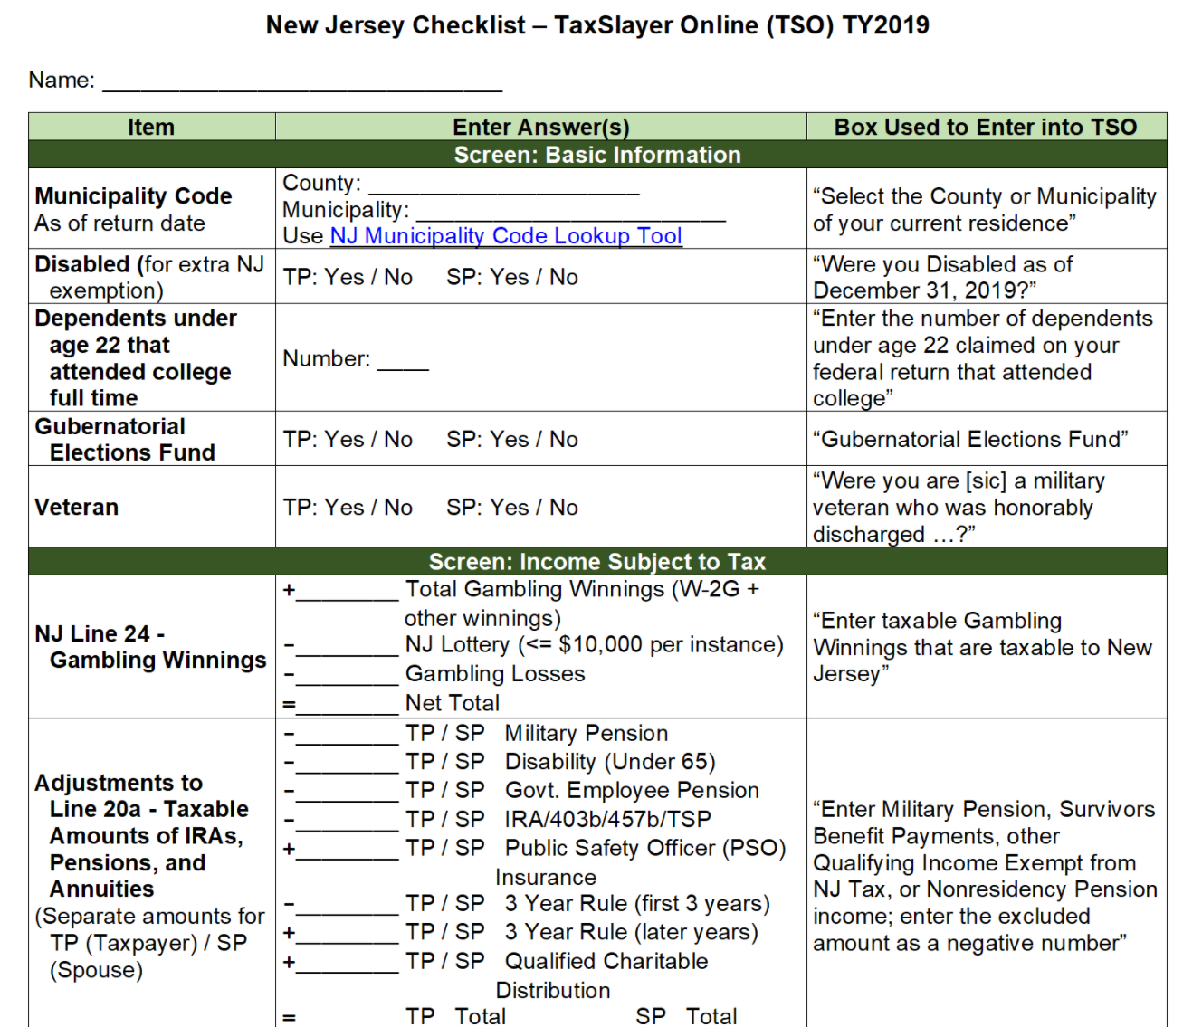
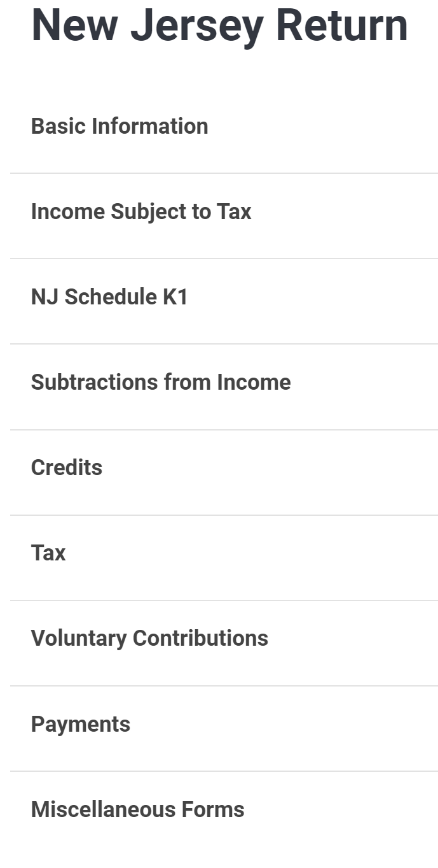
NJ Return Menu in TaxSlayer
Not included in the NJ Checklist

Slide 8
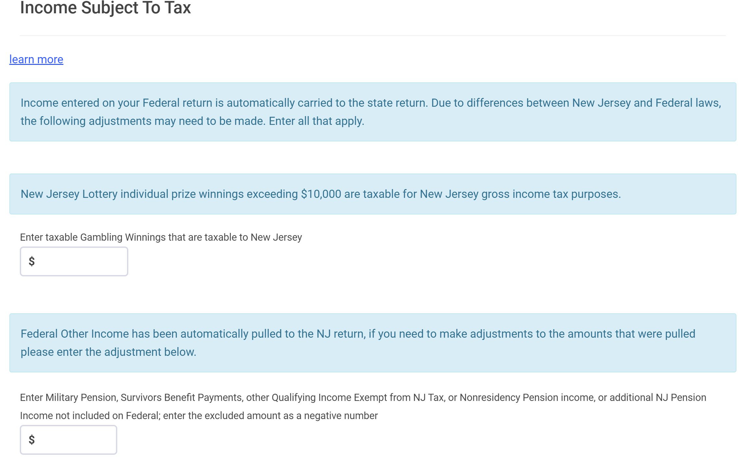
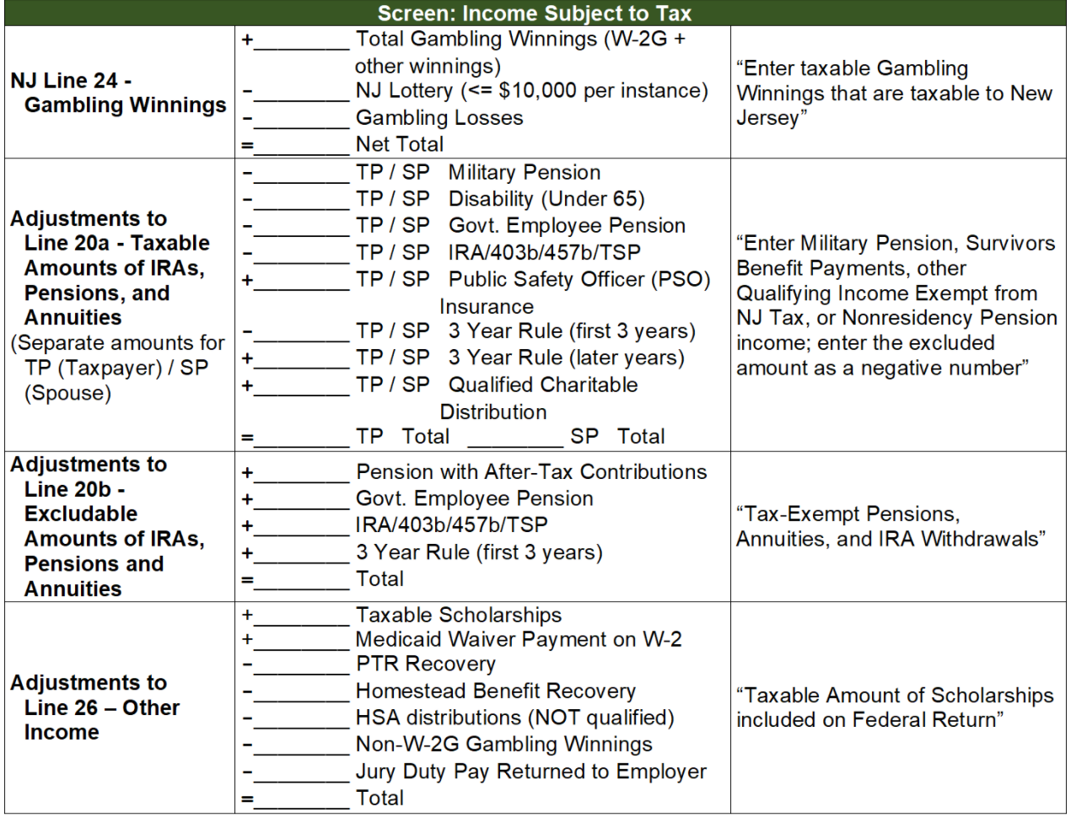
Wording in NJ TSO matches wording in Checklist Cloumn 3

Slide 9
Basic Information
Basic Information
Most of the personal information comes from the federal return
Items shown in this section are additional information necessary for NJ
Complete during interview

Slide 10
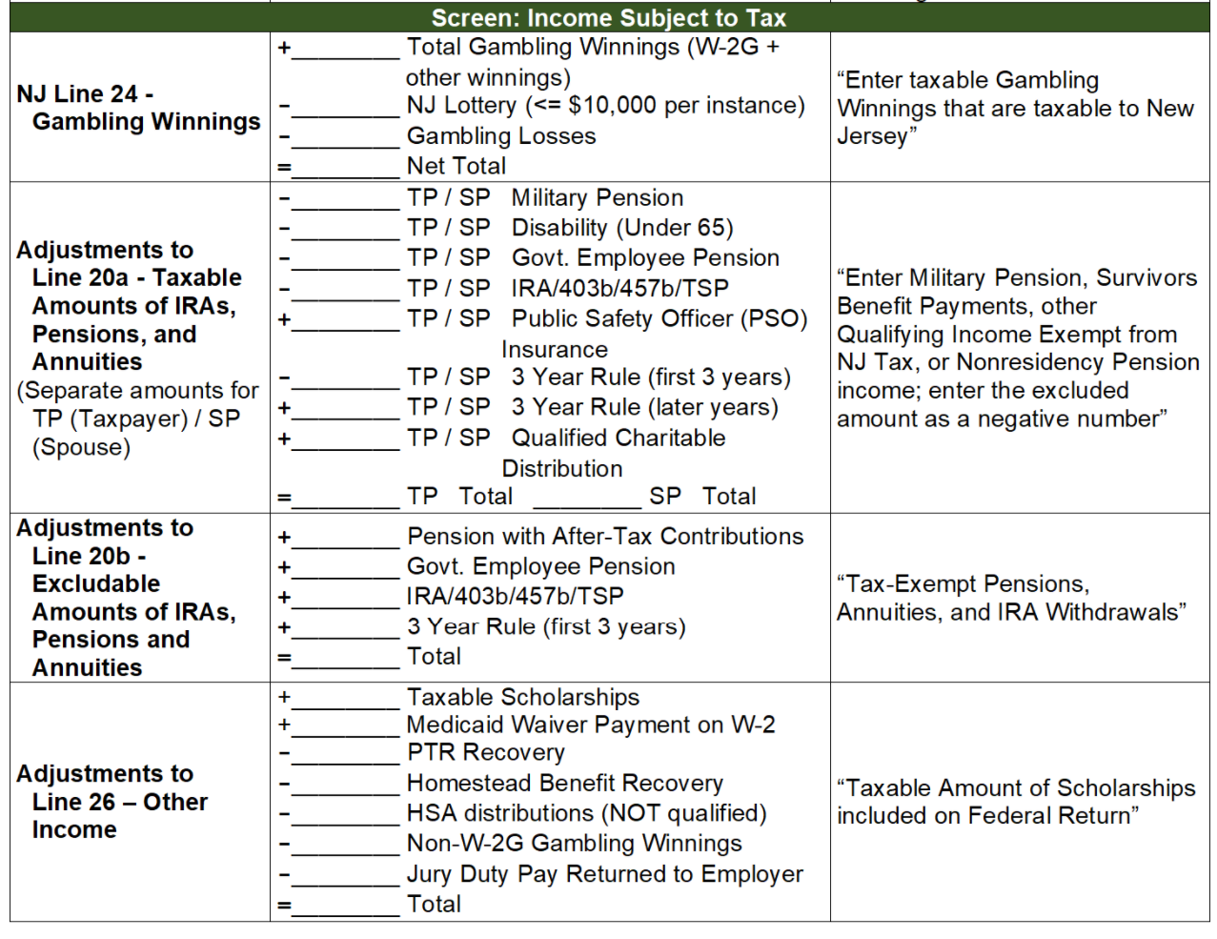
Income Subject to Tax
Income Subject to tax
Note each line item is shown as a + or -.
None of these items are required for Familiarization.
To be covered in future training

Slide 11
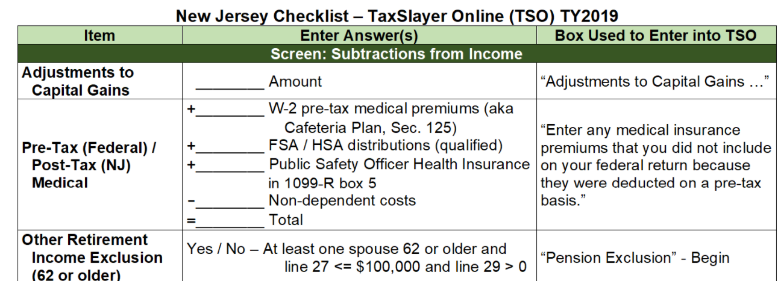
Subtractions from Income
None of this section is used for Familiarization
To be covered in future training

Slide 12
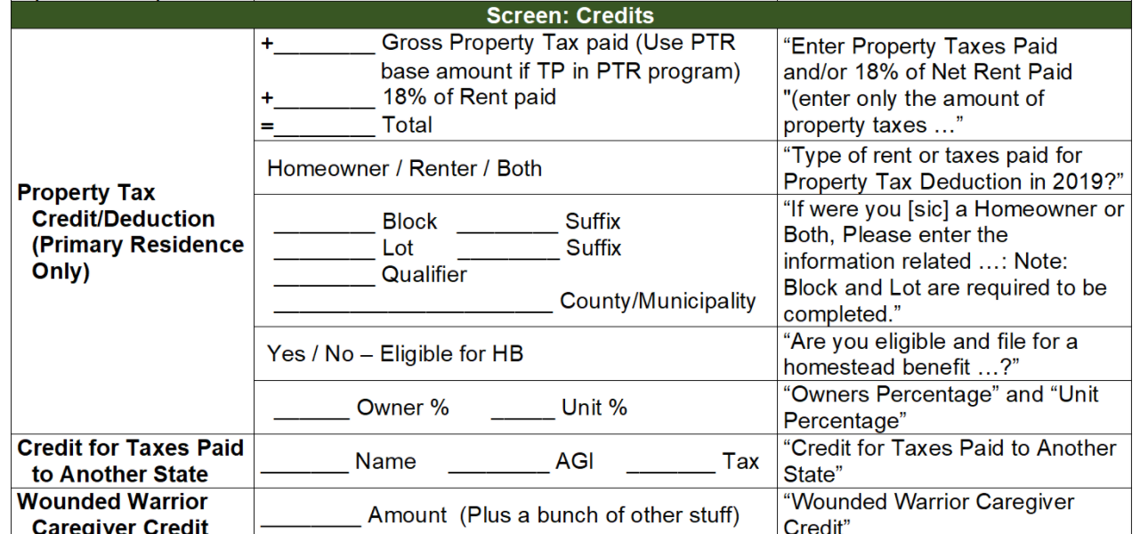
Credits
NJ Property Tax Deduction/Credit
Based on property tax paid or
18% of rent paid or
Both (cannot overlap)
Record block, lot, county/municipality
Record if TP eligible for NJ Homestead Rebate
% of TP ownership or % of unit owned by theTP

Slide 13
Tax
Sales tax on out of State purchases
Health Insurance

Slide 14
Payments
Apply a portion or all of NJ refund to next years tax
Private plan to be discussed later

Slide 15
Miscellaneous Forms
We can print estimated tax payment vouchers if taxpayer desires

Slide 16
Summary
The NJ Checklist is completed as part of the interview as well as during the preparation of the Federal tax return
After the Federal return is completed we use the NJ Checklist to enter the correct information into the NJ section of TaxSlayer
Helps to keep track of NJ information
Helps with Quality Review
Results in a better quality NJ tax return
A NJ Checklist should be prepared for each NJ tax return

Slide 17
Questions

